Slide 1
ROS Service
21AIE213 - Robot Operating System and Robot Simulation

Slide 2
Previous Section
ROS Messages
Defining own Message
ROS Message Format
Compiling the message
Example Message Creation
Useful rosmsg commands
When Should You Make a New Message Type?

Slide 3
Section Overview
ROS Service
Turtlesim ROS Service
Creating ROS Service
Example Service Creation
Implementing a Service
Creating a Server
Creating a Client

Slide 4
ROS Service
Services are another way to pass data between nodes in ROS.
Services are just synchronous remote procedure calls; they allow one node to call a function that executes in another node.
Service calls are well suited to things that you only need to do occasionally and that take a bounded amount of time to complete.

Slide 5
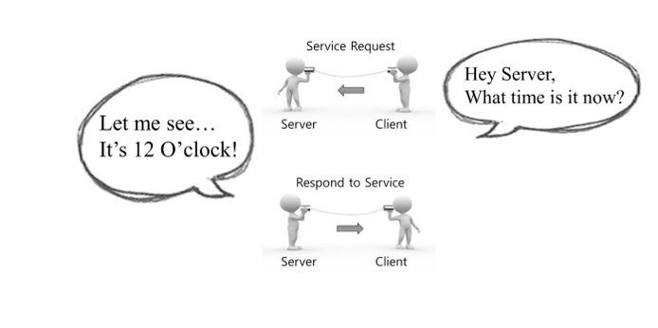
ROS Service
Image Courtesy: Prof. Anis koubaa

Slide 6
ROS Service

Slide 7
ROS Service

Slide 8
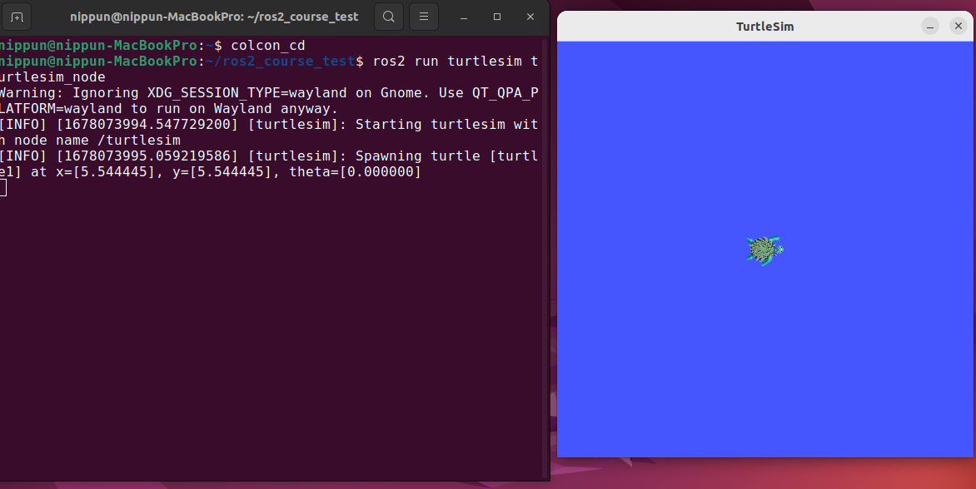
Turtlesim ROS Service

Slide 9
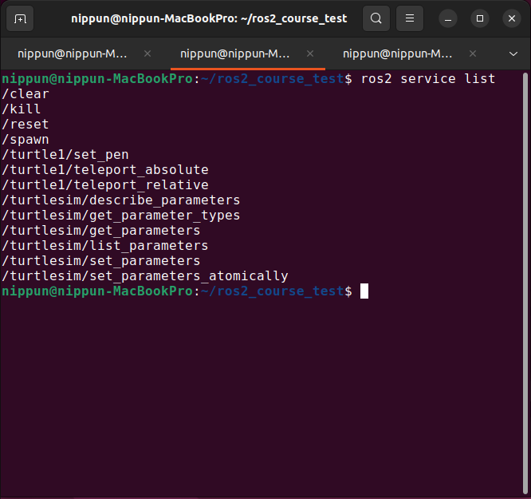
TURTLESIM ROS SERVICE
List of available service : ros2 service list

Slide 10
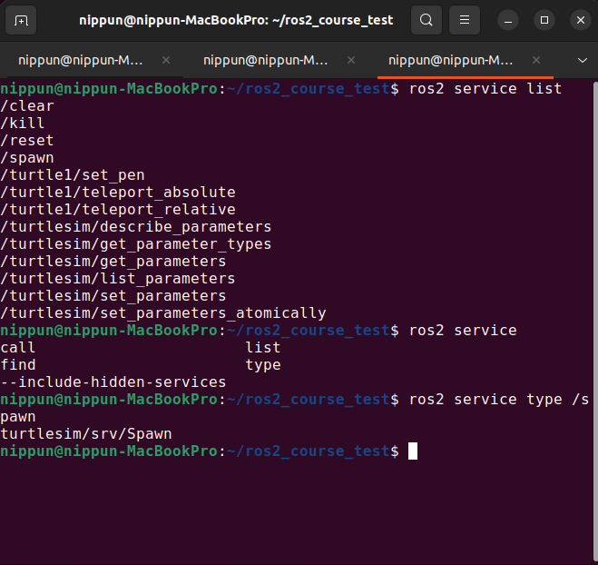
TURTLESIM ROS SERVICE
Service information: ros2 service type /spawn

Slide 11
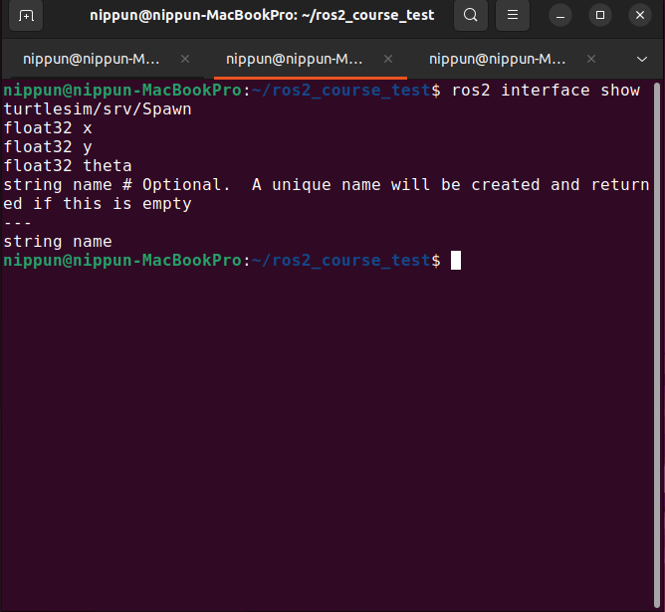
TURTLESIM ROS SERVICE
Service information: ros2 interface show turtlesim/srv/Spawn

Slide 12
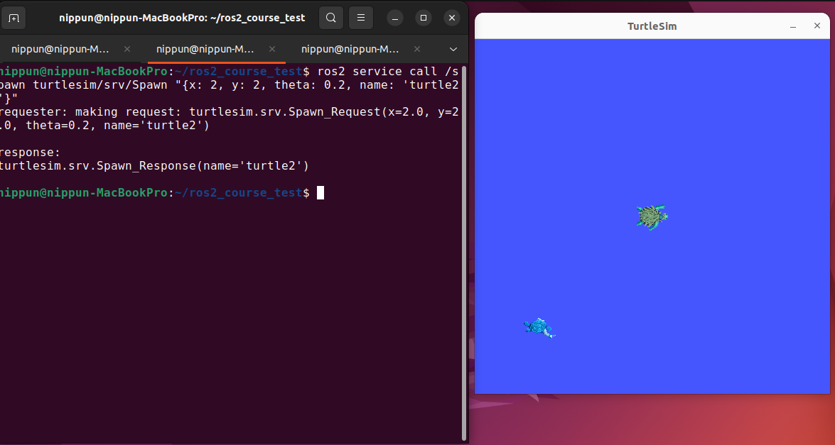
TURTLESIM ROS SERVICE
Calling ROS service: ros2 service call /spawn turtlesim/srv/Spawn "{x: 2, y: 2, theta: 0.2, name: 'turtle2'}"

Slide 13
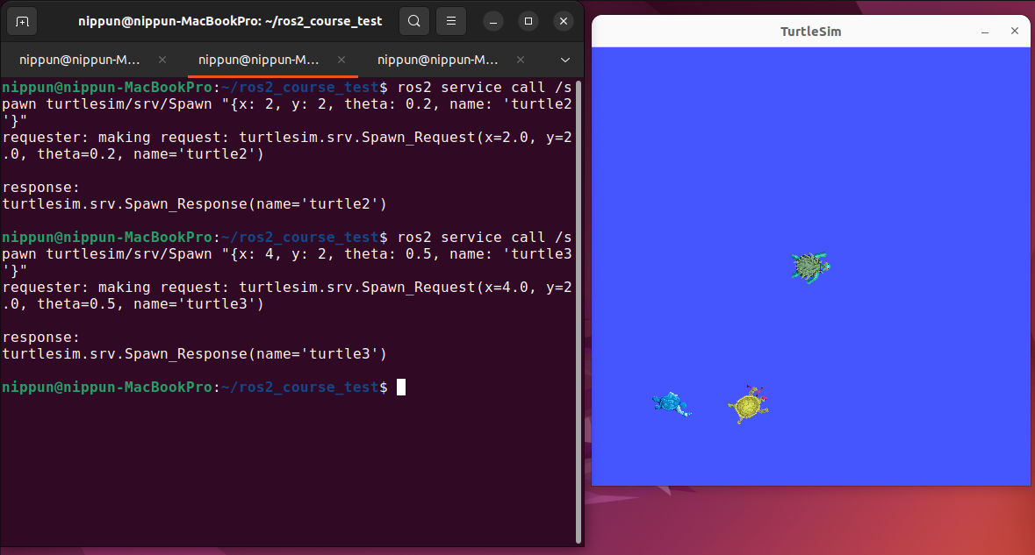
TURTLESIM ROS SERVICE
Calling ROS service: rosservice call /spawn 7 7 1.57 turtle3

Slide 14
Creating ROS Service
The first step in creating a new service is to define the service call inputs and outputs.
This is done in a service-definition file, which has a similar structure to the message-definition files we’ve already seen.
However, since a service call has both inputs and outputs, it’s a bit more complicated than a message.
Lets take an example of AddTwoInt as a service
Inputs: Integers number x, y
Output: sum of the input

Slide 15
Defining A service
Five Steps to Define New ROS Service
1. Create a new folder named "srv" in root of the package
2. Inside srv folder create a new service file named "Servicename.srv"
3. Define the new service in the service file
4. Update CMakeList.txt and package.xml file to compile the new message into language-specific implementations
Build the package and Source the devel/setup.bash file

Slide 16
ROS Service Format
Service.srv
InputType1 InputFieldName1
InputType2 InputFieldName2
InputType3 InputFieldName3
---
ResponseType ResponseName

Slide 17
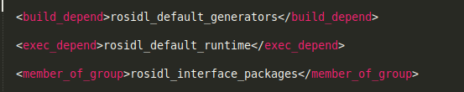
Compiling the Service
Before compiling the new service, changes have to be made in CMakeList.txt and package.xml files to make catkin identify the new message
In package.xml file, add the below lines

Slide 18
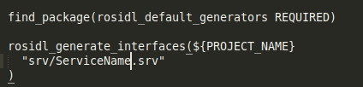
COMPILING THE Service
In CMakeList.txt file do the following changes
Go to the root of your workspace, and build the package
Type command : source catkin_workspace/devel/setup.bash
Will create new message named Your_Service, Your_ServiceRequest and Your_ServiceResponce

Slide 19
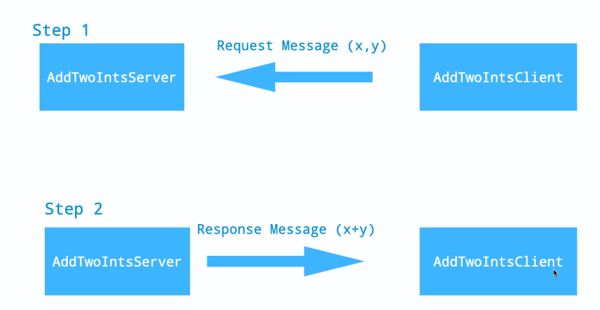
Example Service Creation

Slide 20
EXAMPLE SERVICE CREATION
Create a package named "add_two_ints" and a sub directory named srv
Store the AddTwoInt.srv file in the srv directory.
Change the configuration files accordingly
Build the package and source the devel/setup.bash
Create a new package named "adding_integers" and write a python server and client for the AddTwoInt service
Change the setup.py file to enter the starting point

Slide 21
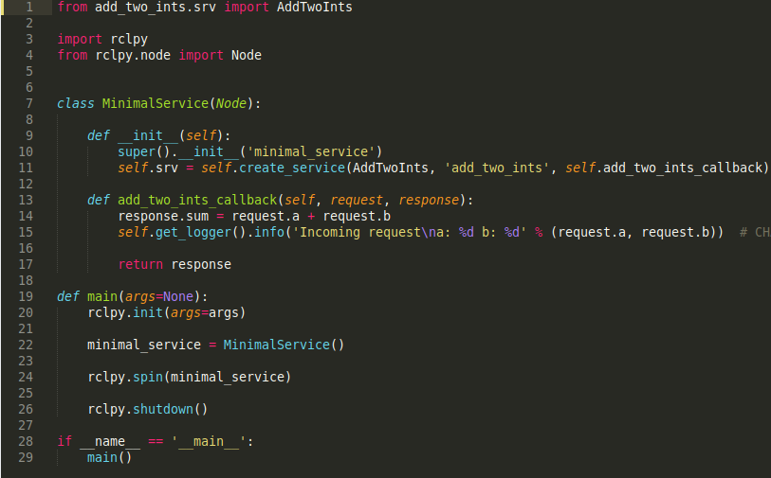
Implementing a Service
Creating a Server

Slide 22
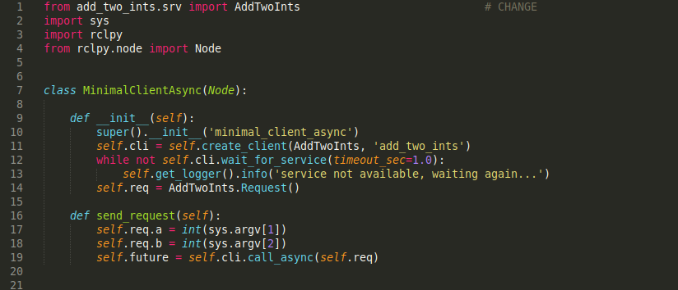
Creating A Client

Slide 23
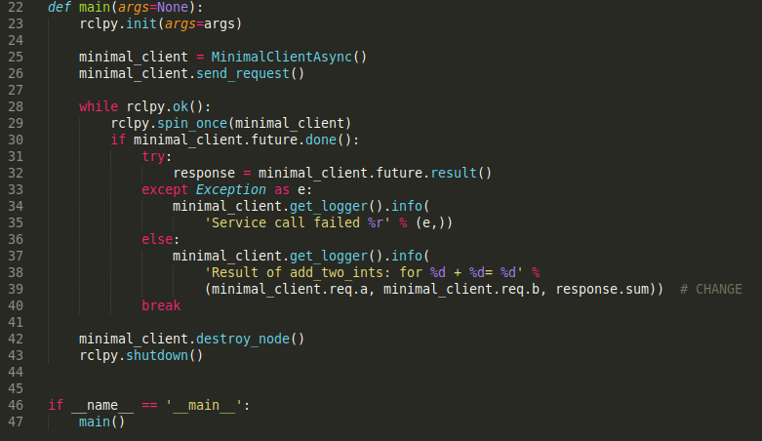
CREATING A CLIENT

Slide 24
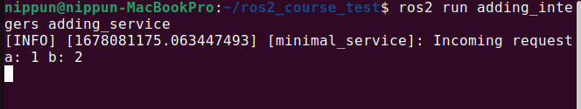
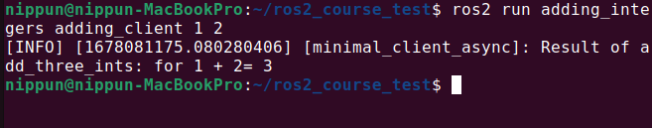
Output

Slide 25
Thank You !!!

